Slide 1
Ensemble Methods and Decision Trees
Premkumar Chandra Shegaran

Slide 2
Decision Trees

Slide 3
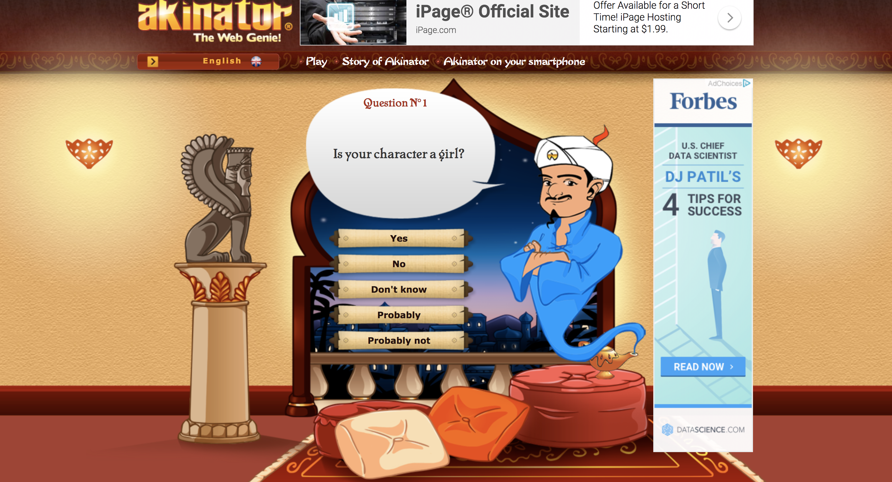
Motivating Example

Slide 4
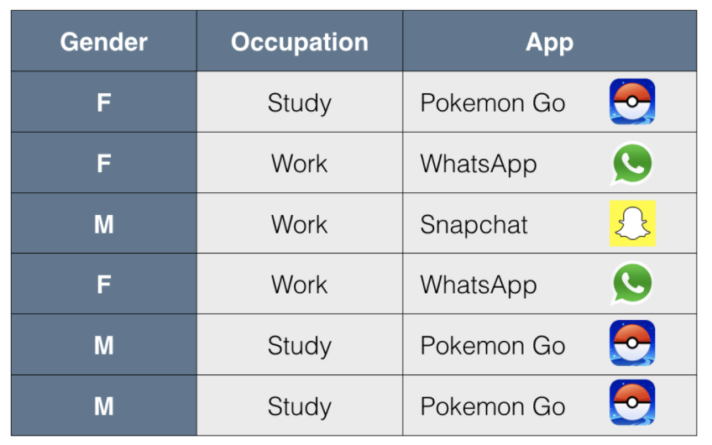
Recommending Apps
For a woman who works at a office what app do we recommend?
For a man who works in a factory, what app do we recommend?
For a girl who goes to high school which app do we recommend?
Great! But that is how we humans work, how do you get a computer to do this?

Slide 5
Recommending Apps
Between Gender and Occupation, which one seems more decisive for predicting what app will the users download?

Slide 6
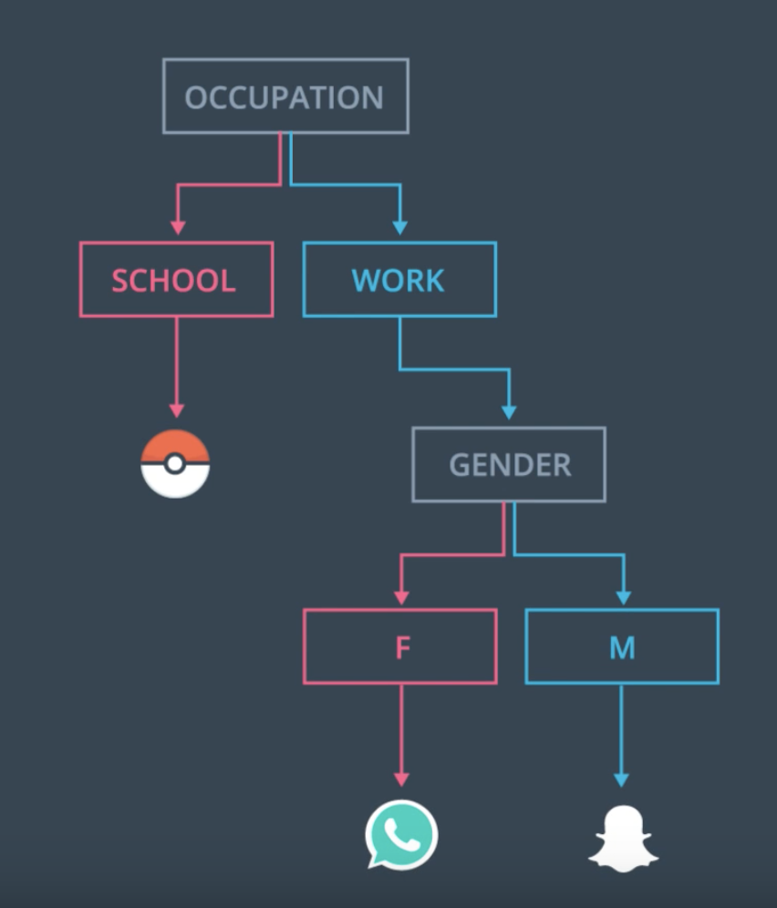
Recommending Apps

Slide 7
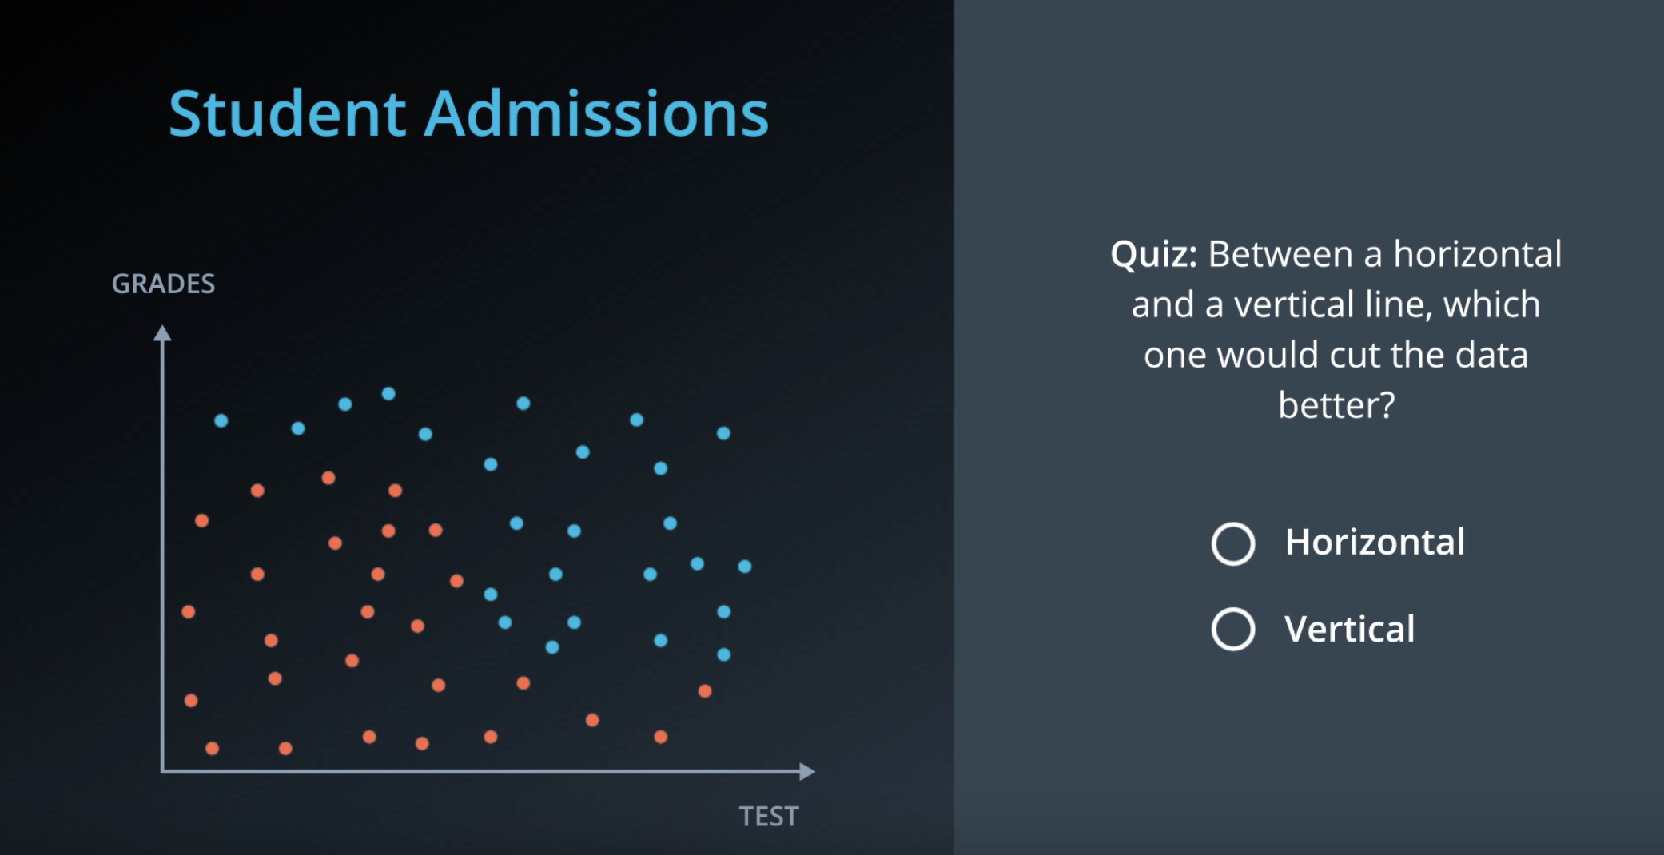

Slide 8
Entropy

Slide 9
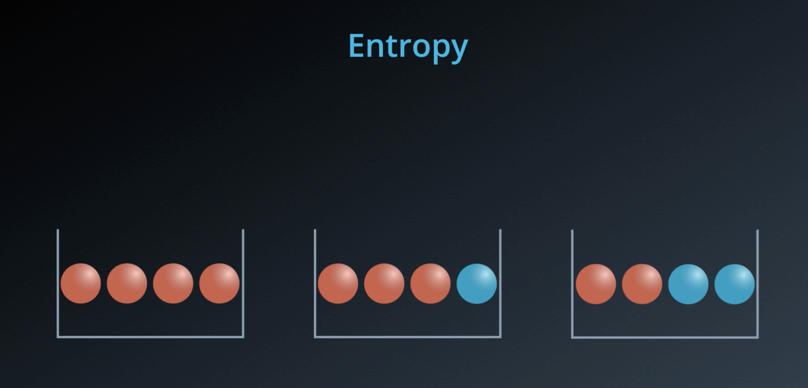

Slide 10
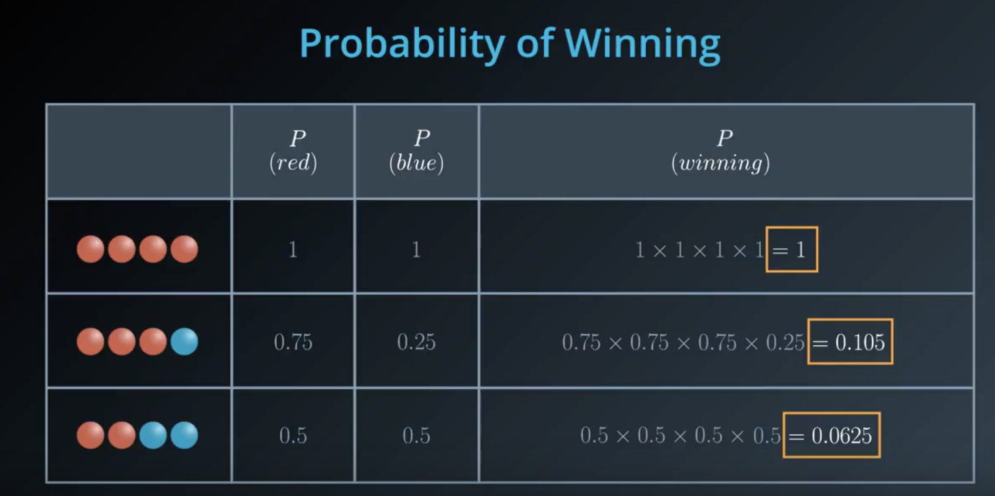

Slide 11
Products are bad, sums are good
Which function will help us turn products to sums:
Sin
Cos
Exp
Log

Slide 12
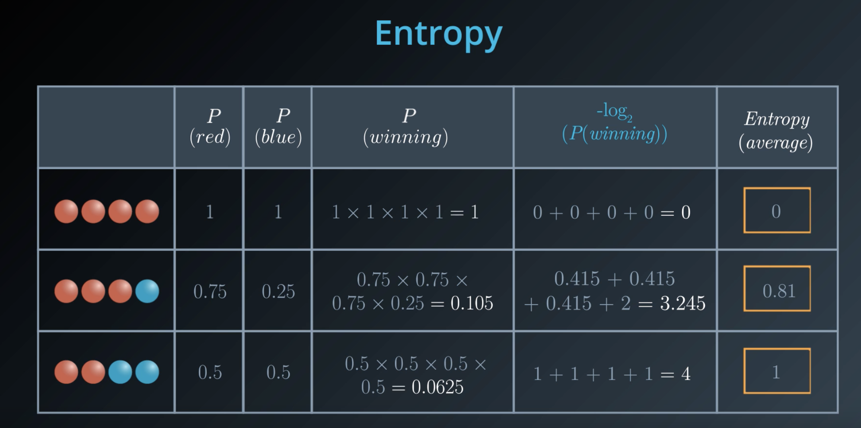

Slide 13
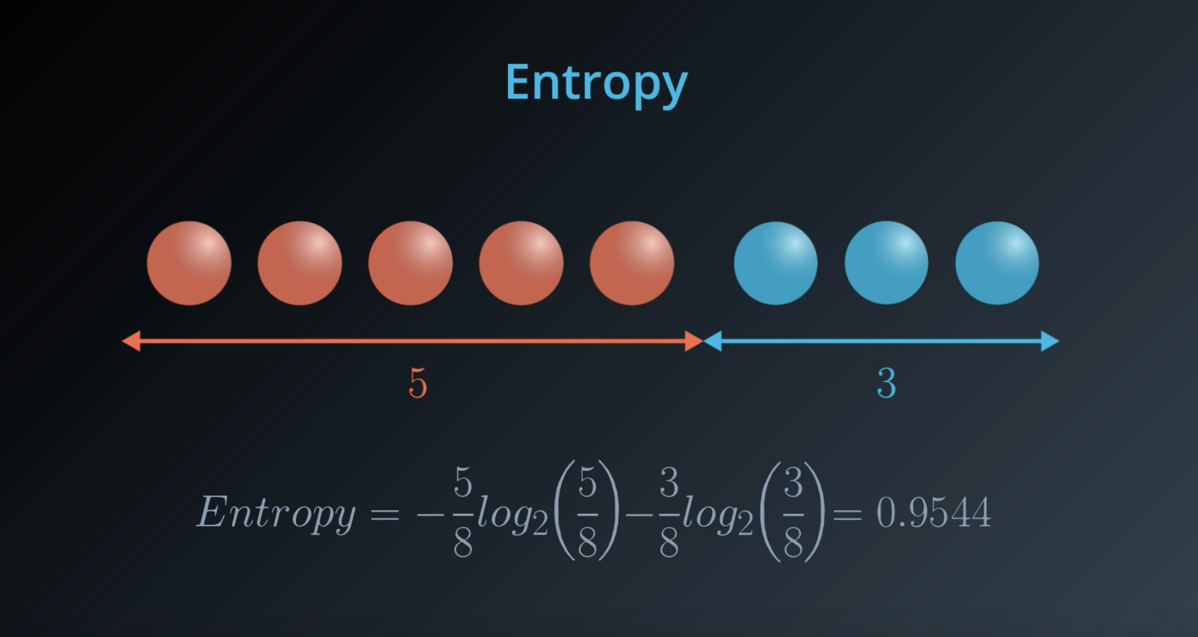

Slide 14
Information Gain

Slide 15
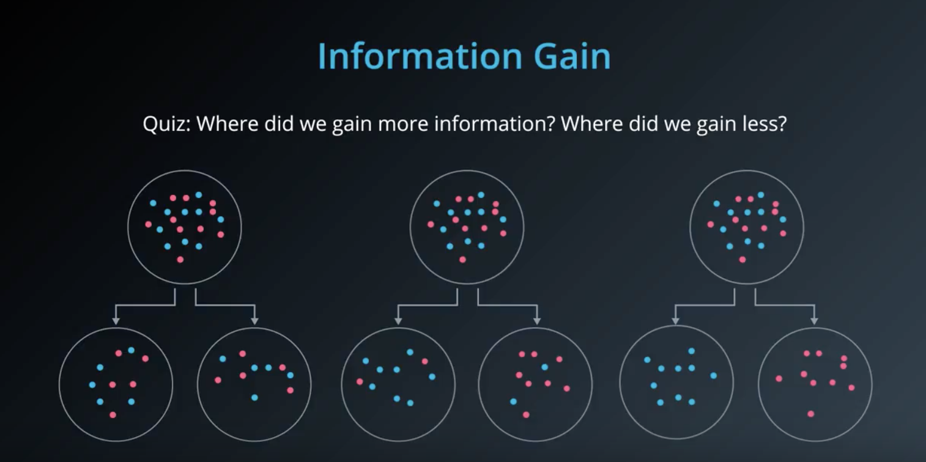

Slide 16
Calculate the Information Gain for each..

Slide 17
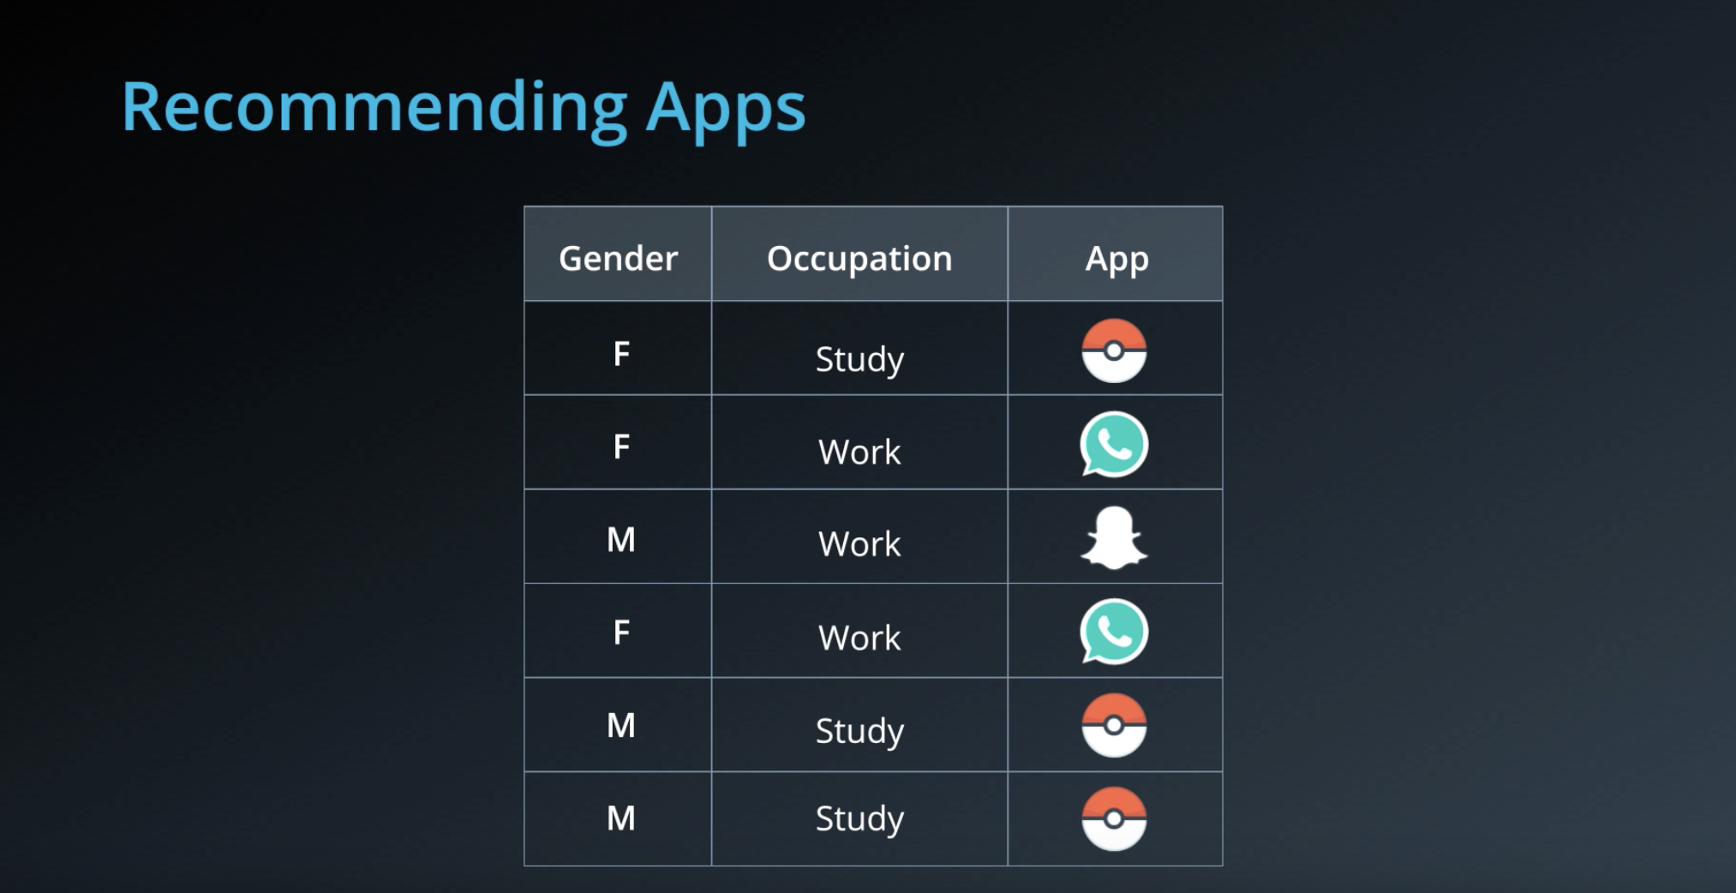
Calculate the Information Gain for feature..

Slide 18
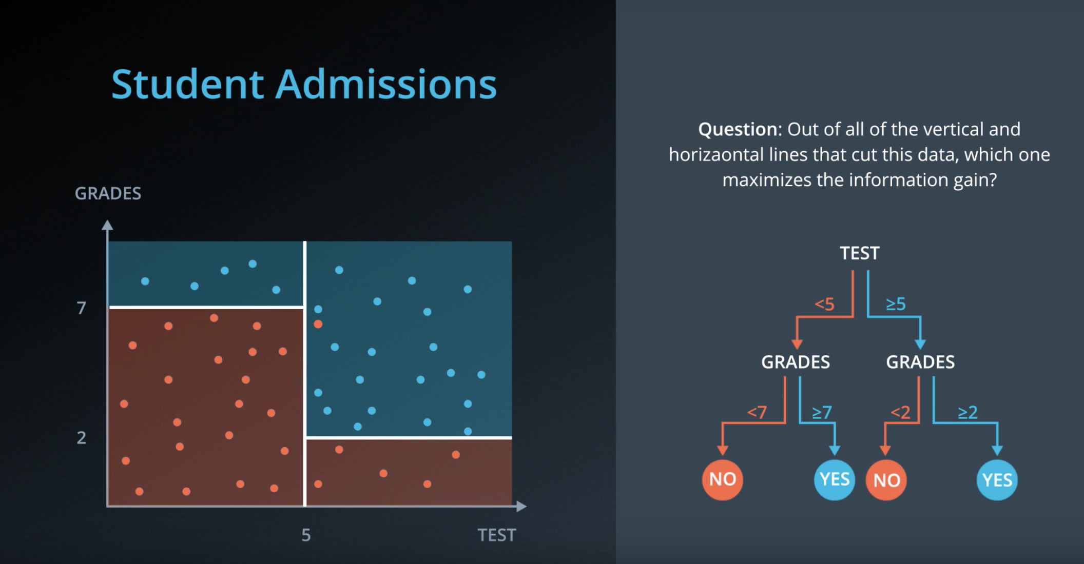

Slide 19
Hyperparameters

Slide 20
Decision Trees in Sklearn using Titanic Survival data Go to Exercise

Slide 21
Pros and Cons of Decision Trees

Slide 22
Random Forest

Slide 23
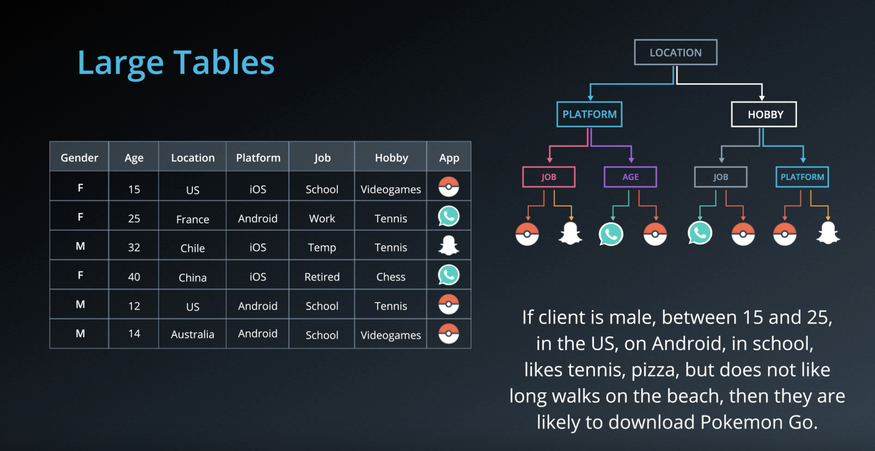
Problem with Decision Trees
OVERFITTING

Slide 24
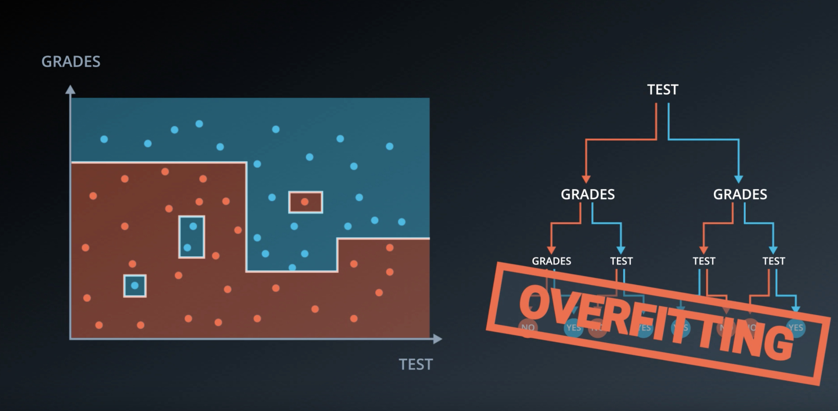

Slide 25
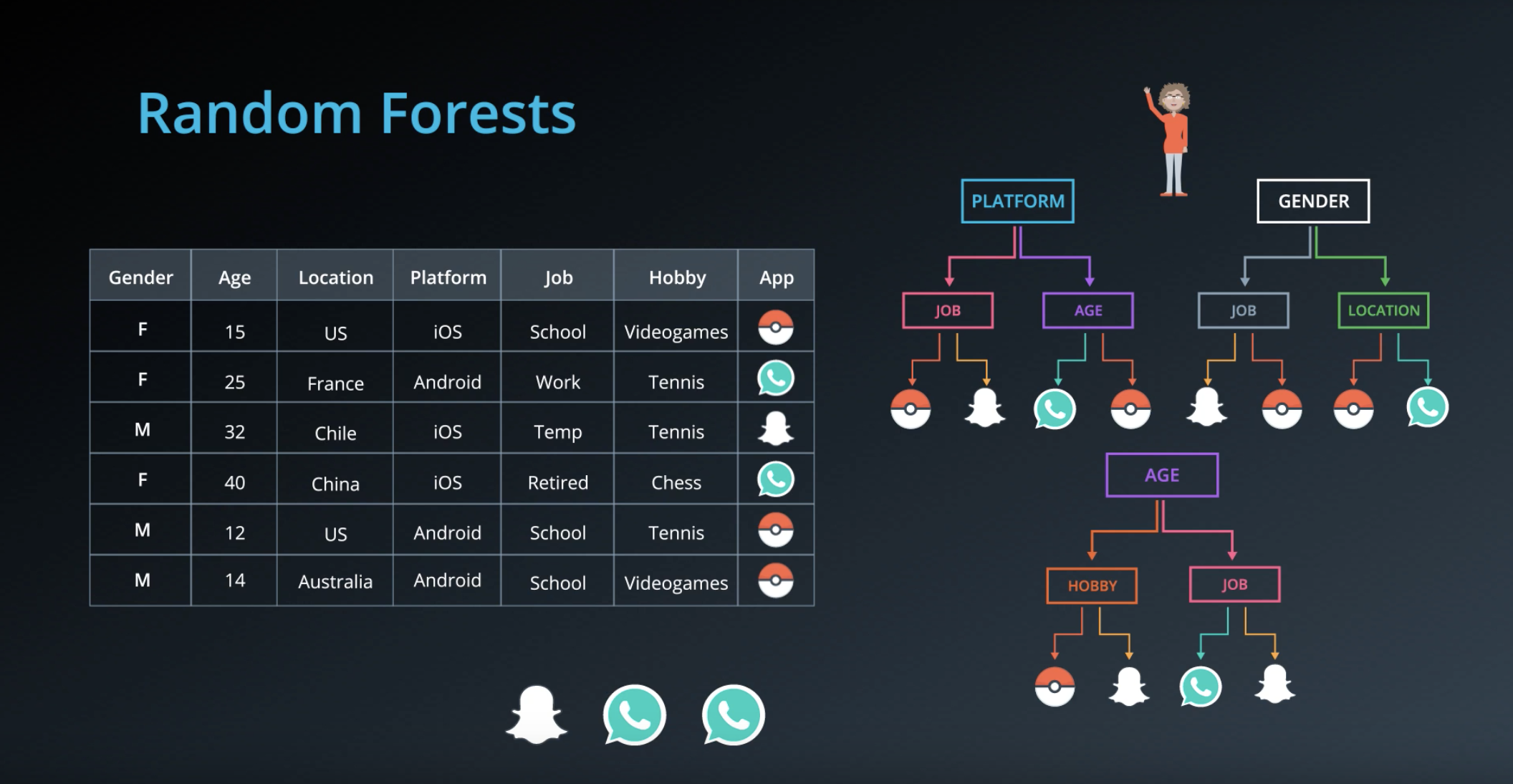

Slide 26
Boosting - ADABOOST

Slide 27
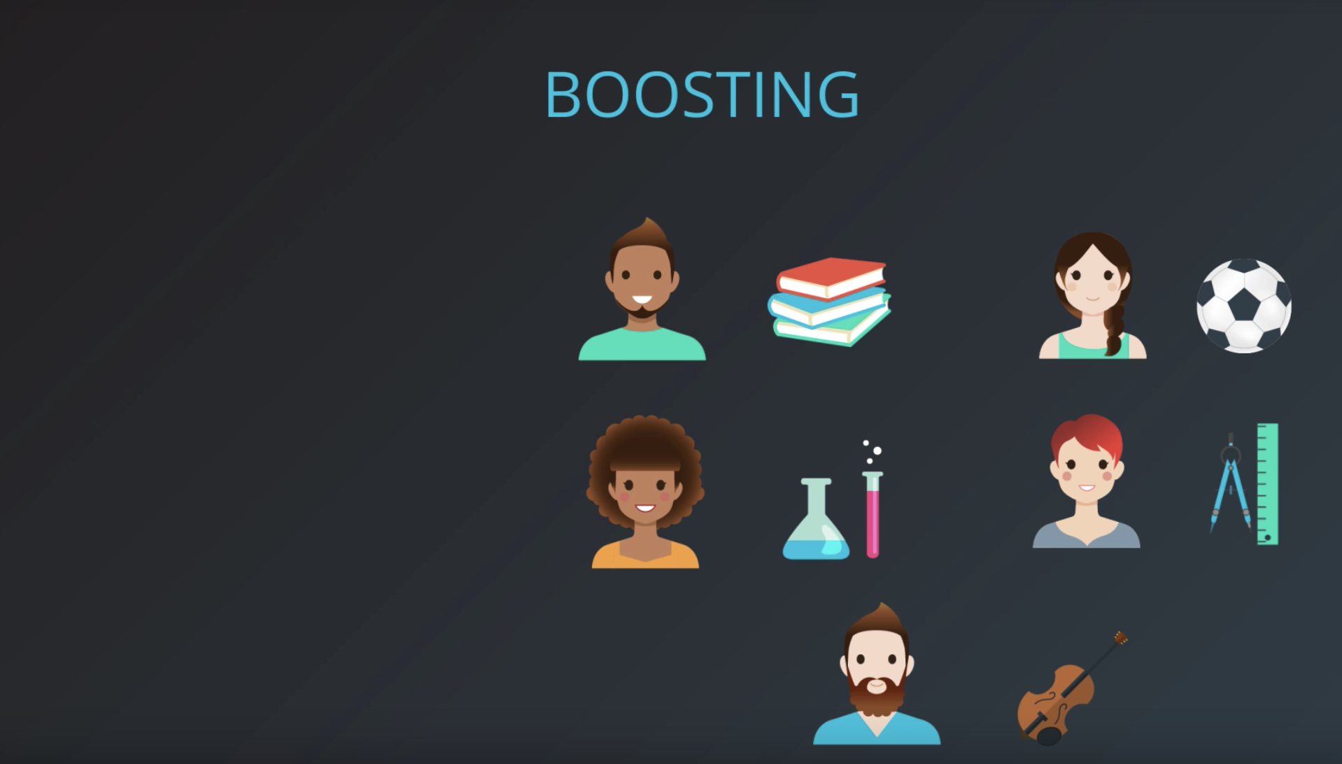


Slide 28


Slide 29
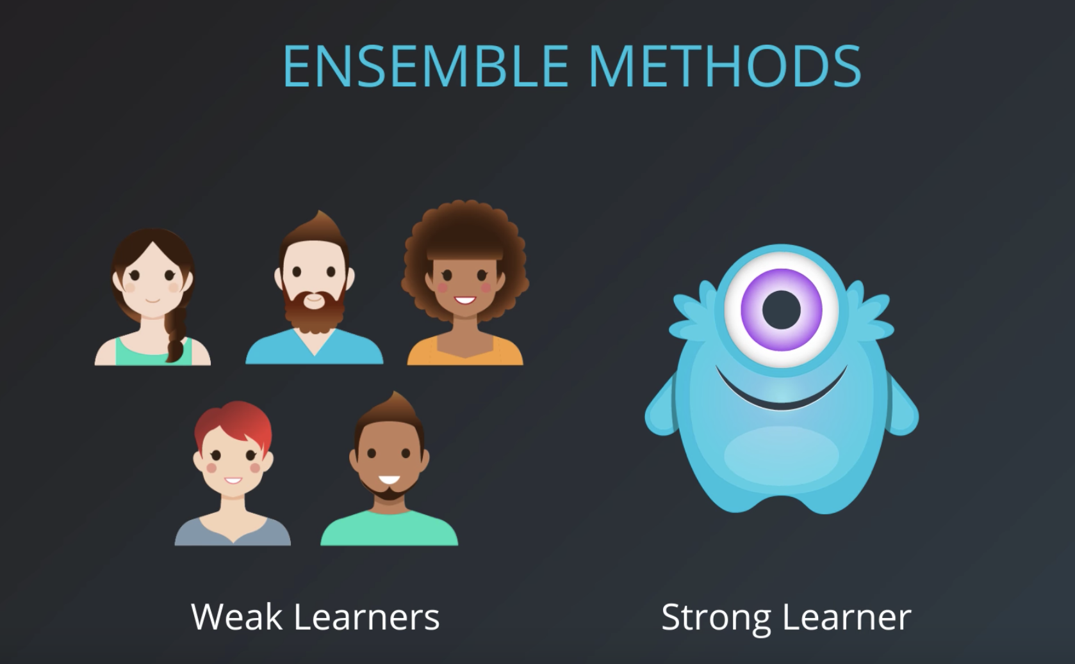

Slide 30
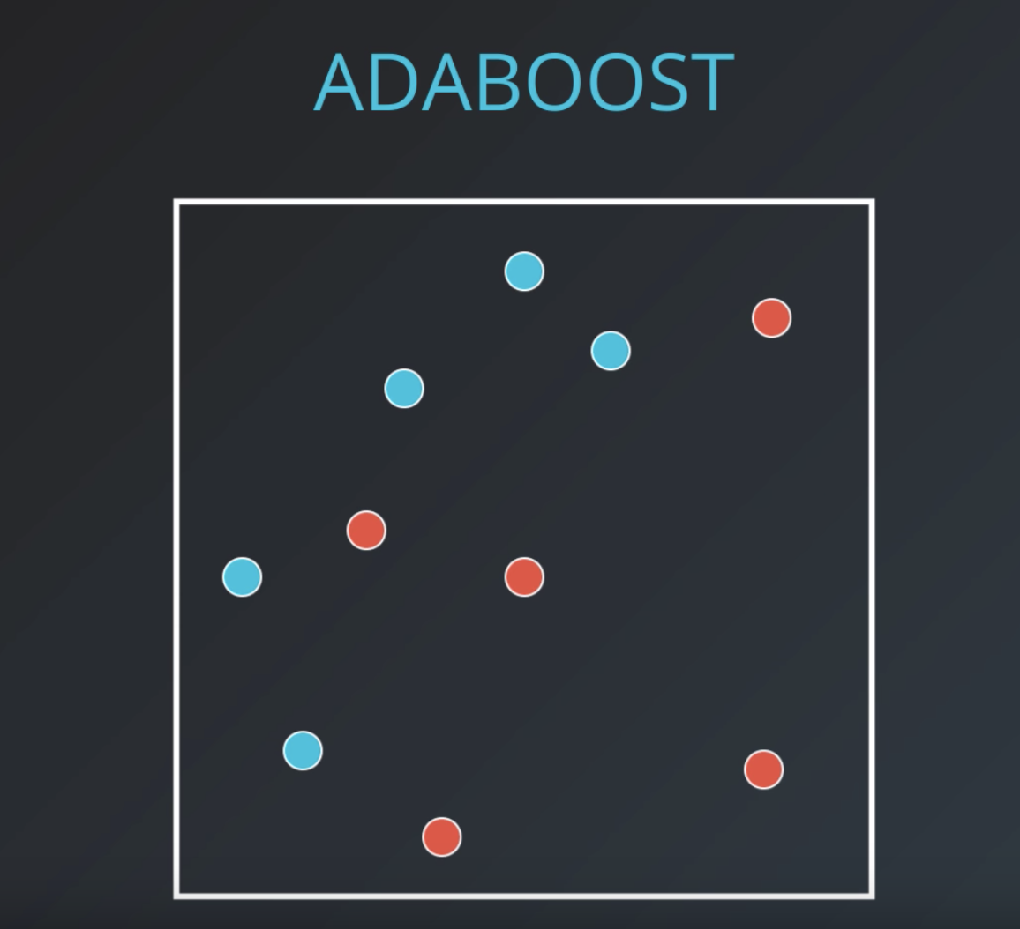
Goal:
To fit 3 different learners (weak learners) to minimize errors/maximize accuracy

Slide 31
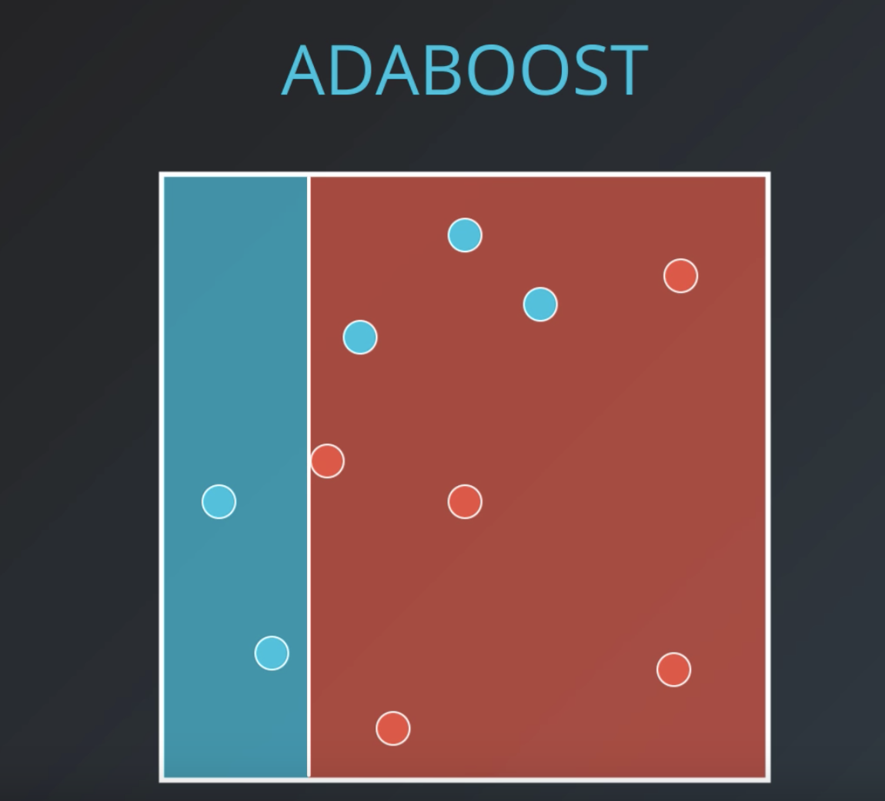
First learner:
Best fit is to have only 3 errors

Slide 32
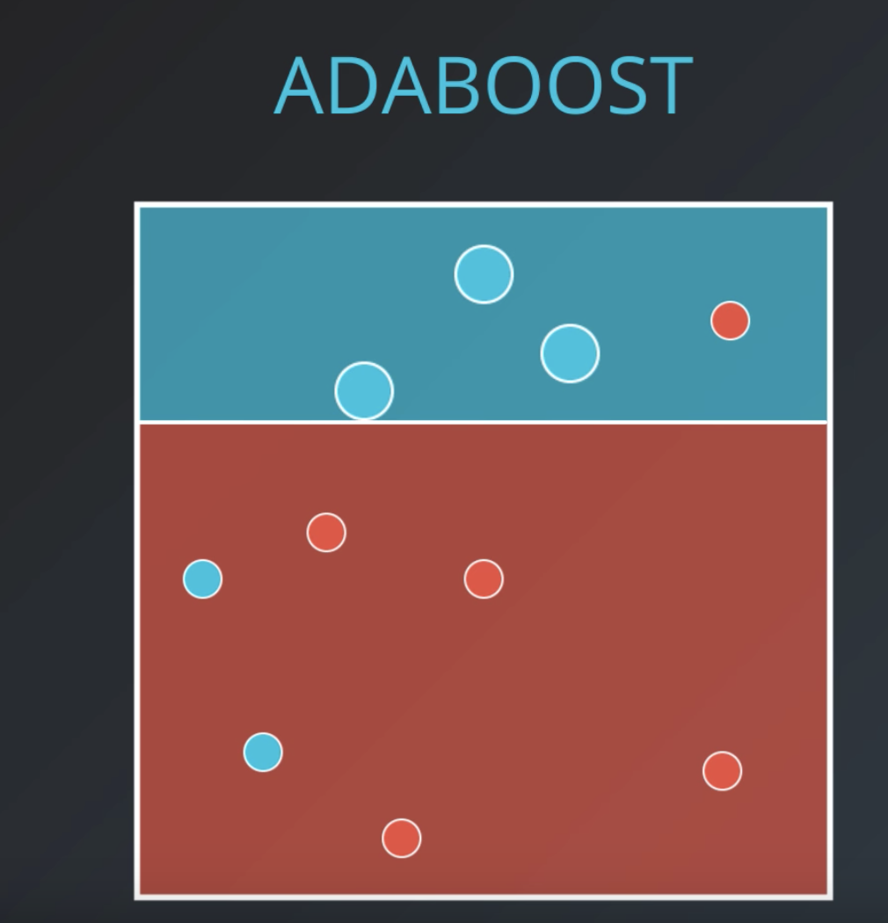
Second learner:
The wrong points are increased in weight to make sure the second learner doesn’t miss this

Slide 33
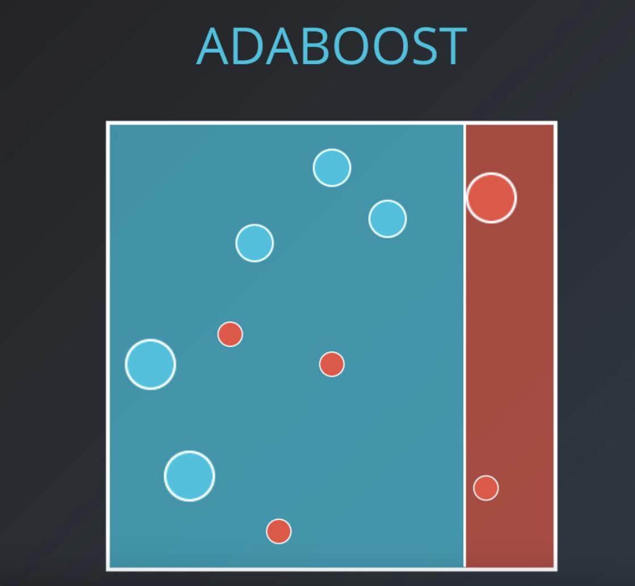
Third learner:
The wrong points are increased in weight to make sure the second learner doesn’t miss this

Slide 34
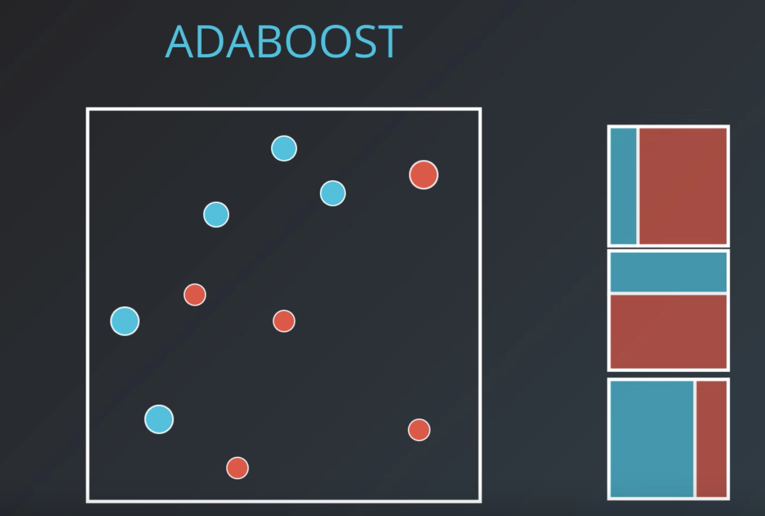

Slide 35
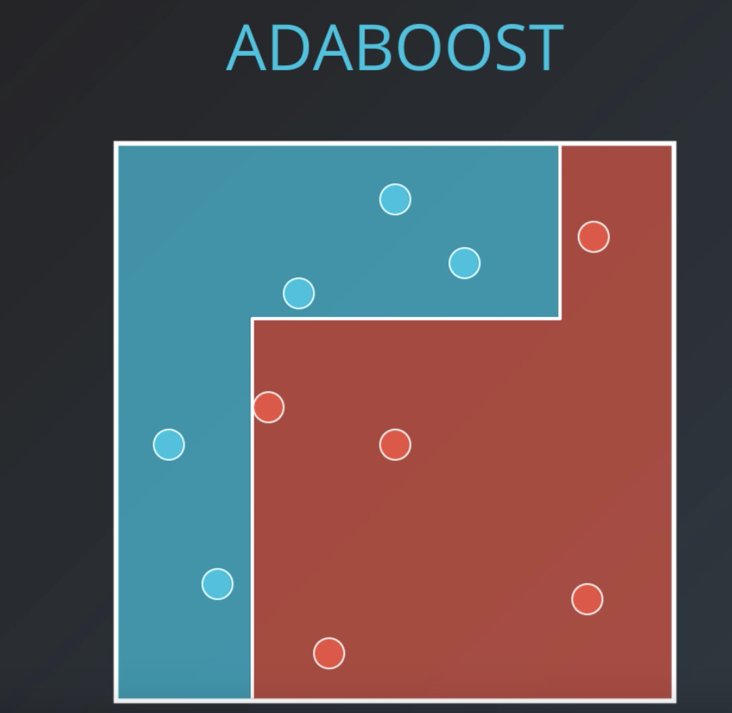
How do we get the computer to interpret this..
By assigning weights..

Slide 36
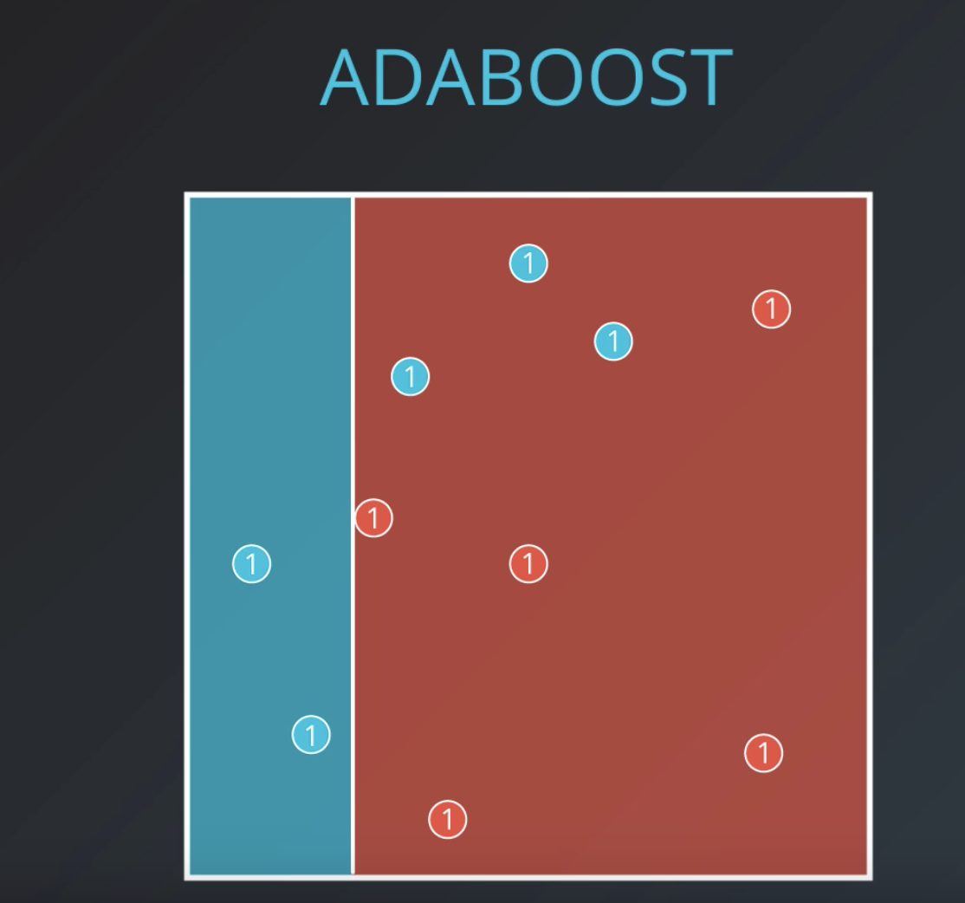
Goal:
Minimize sum of weights of the incorrectly classifieds points

Slide 37
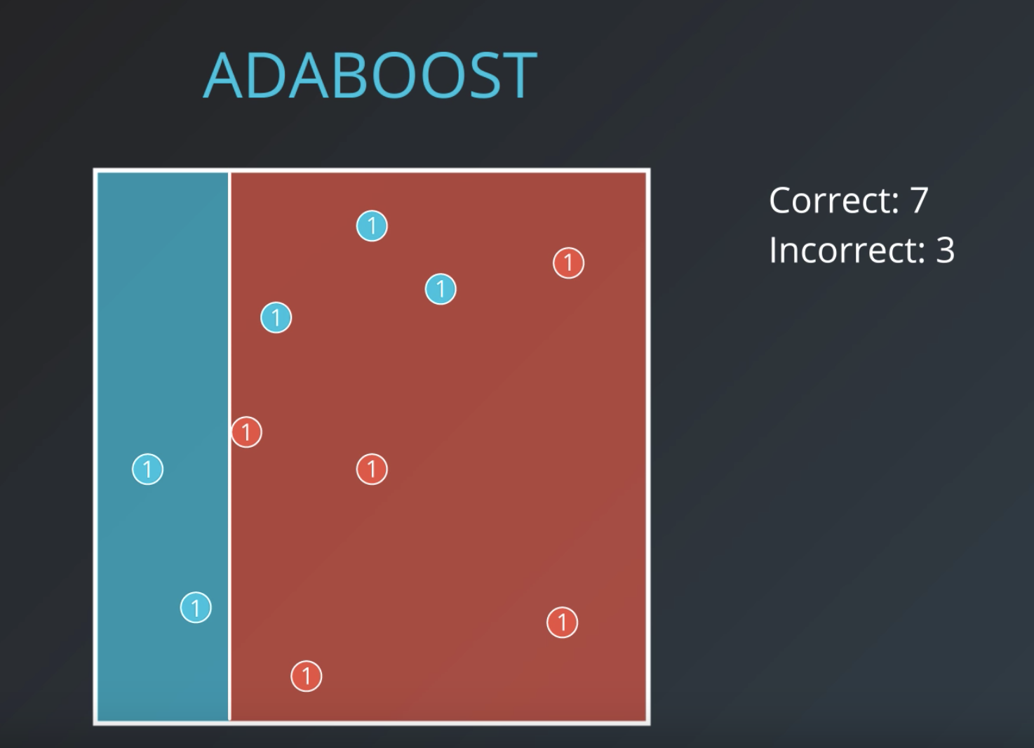

Slide 38
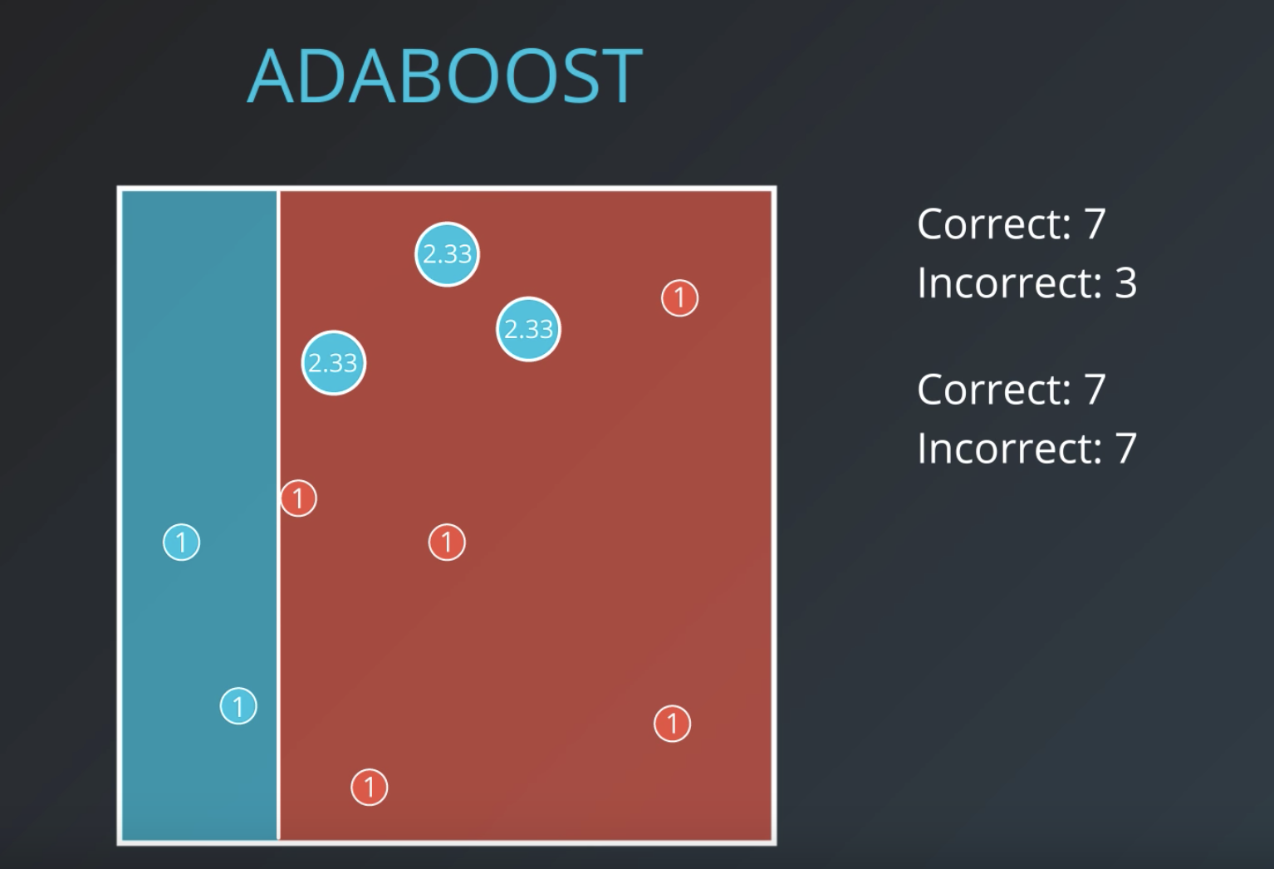

Slide 39
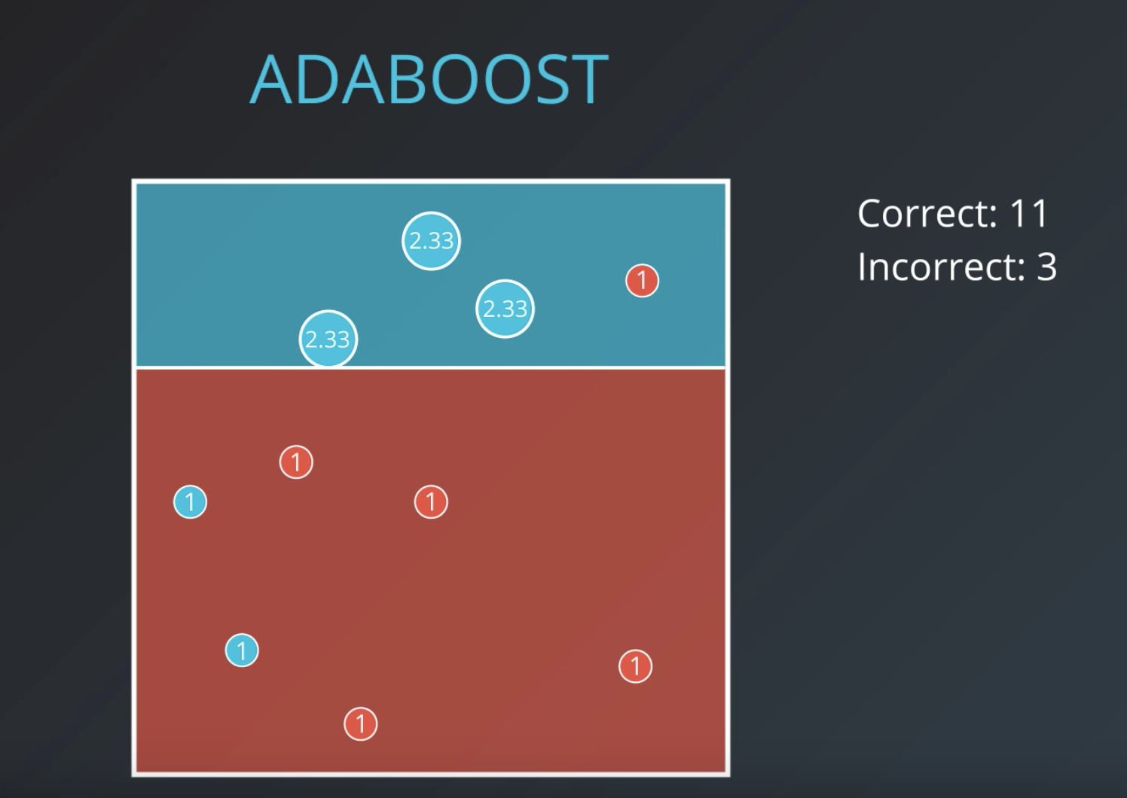

Slide 40
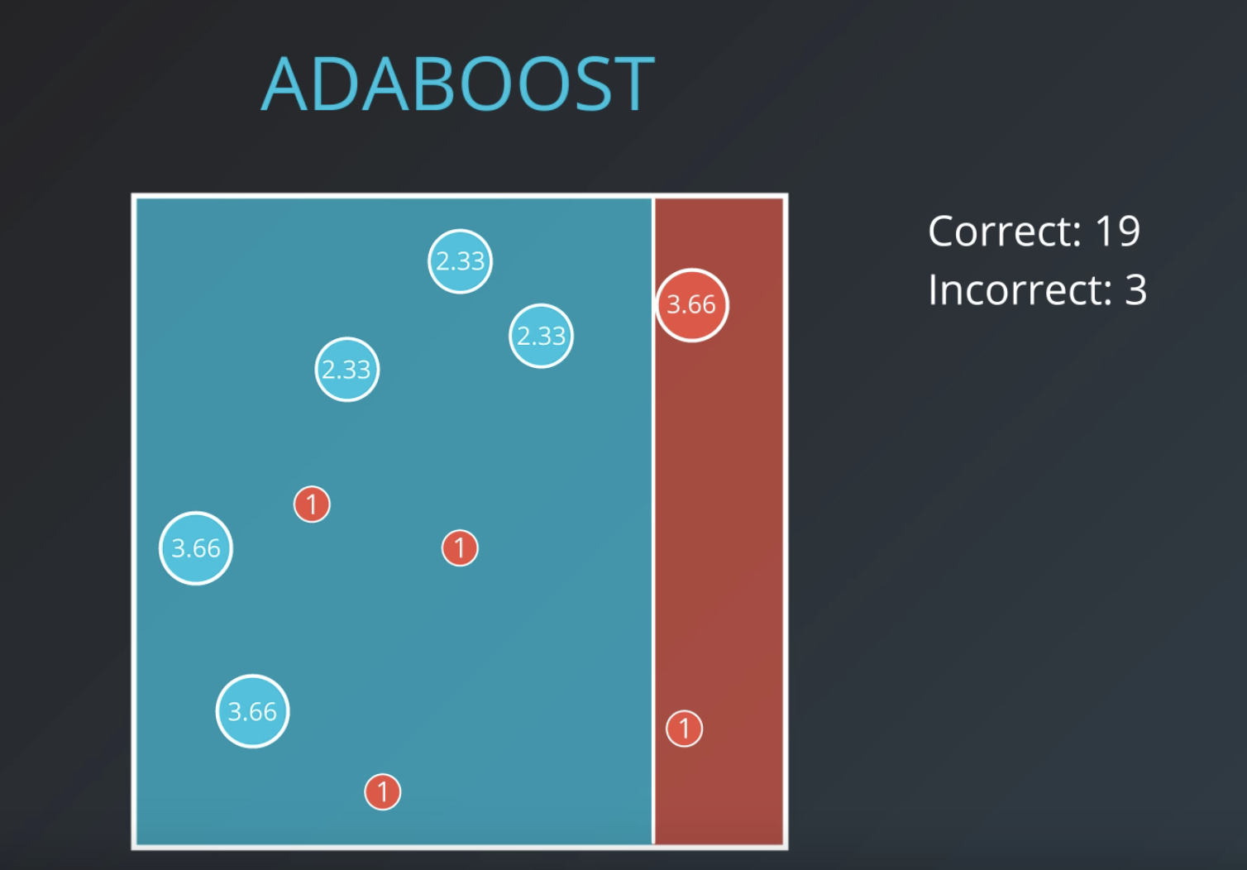

Slide 41
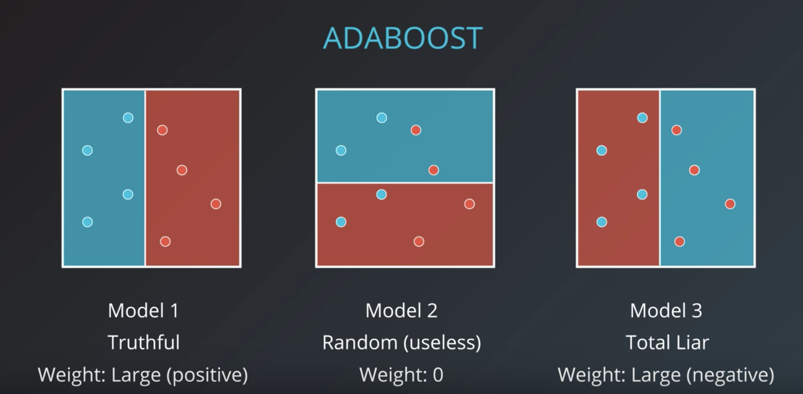

Slide 42
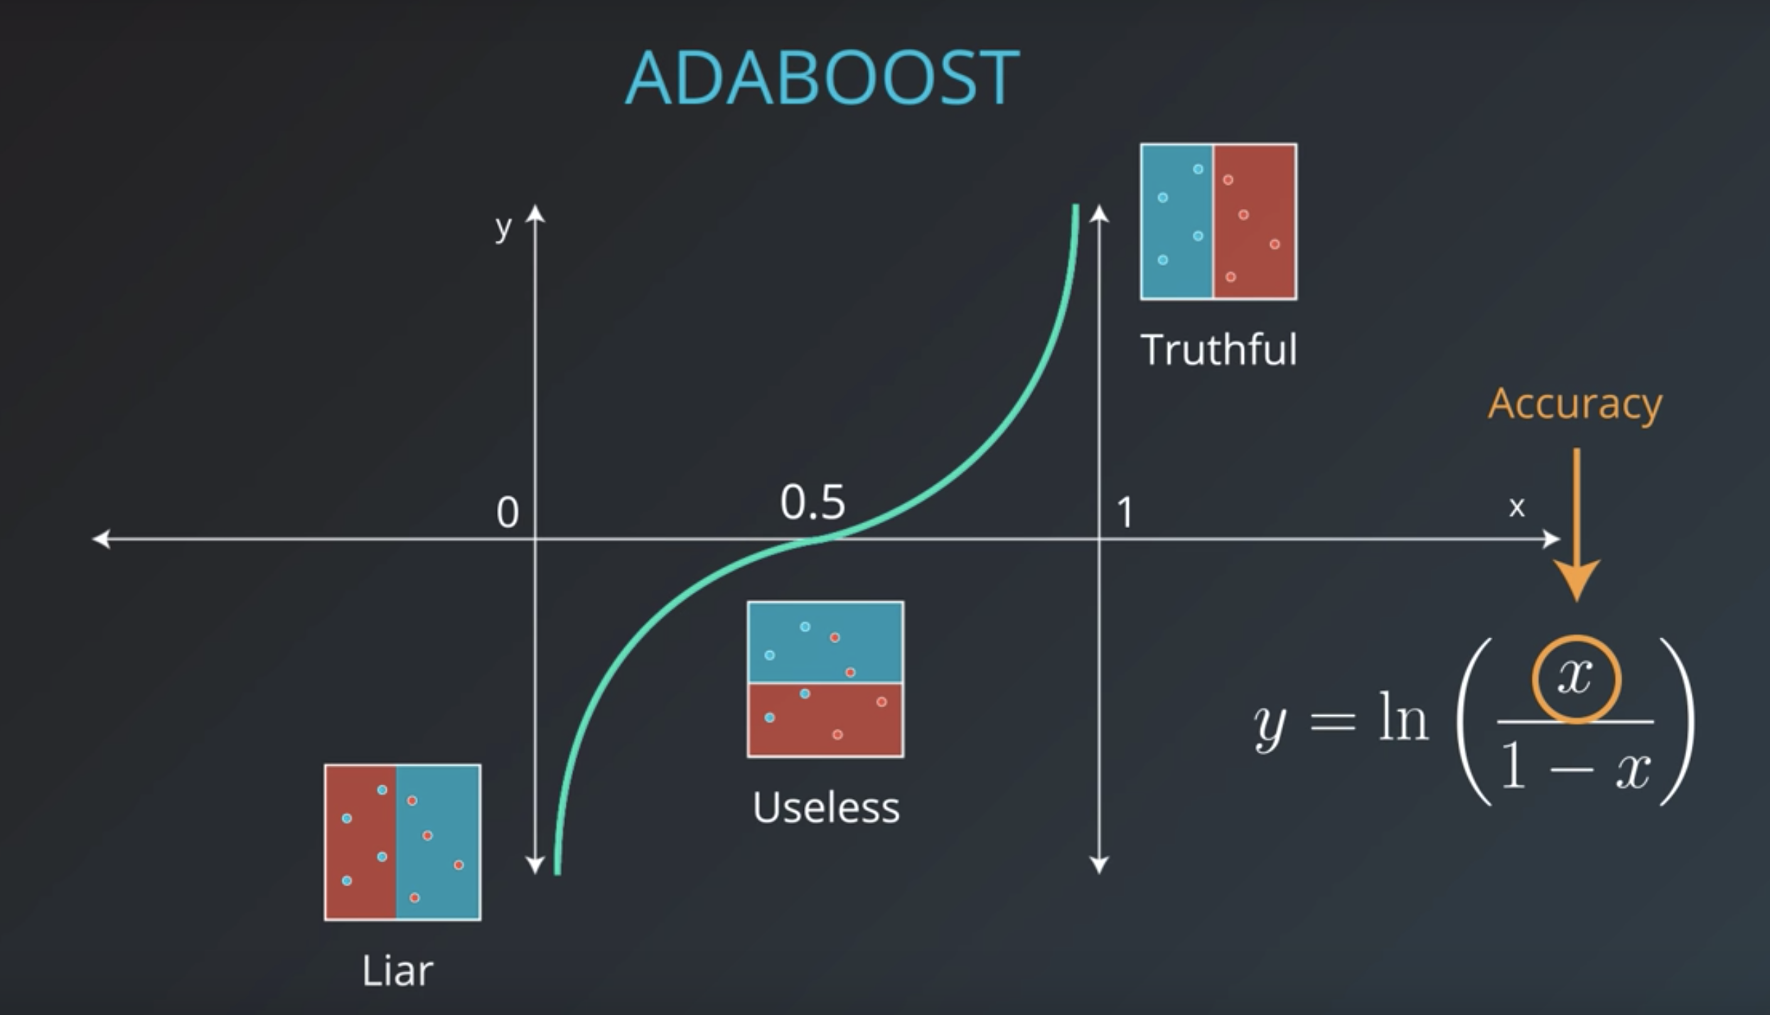

Slide 43
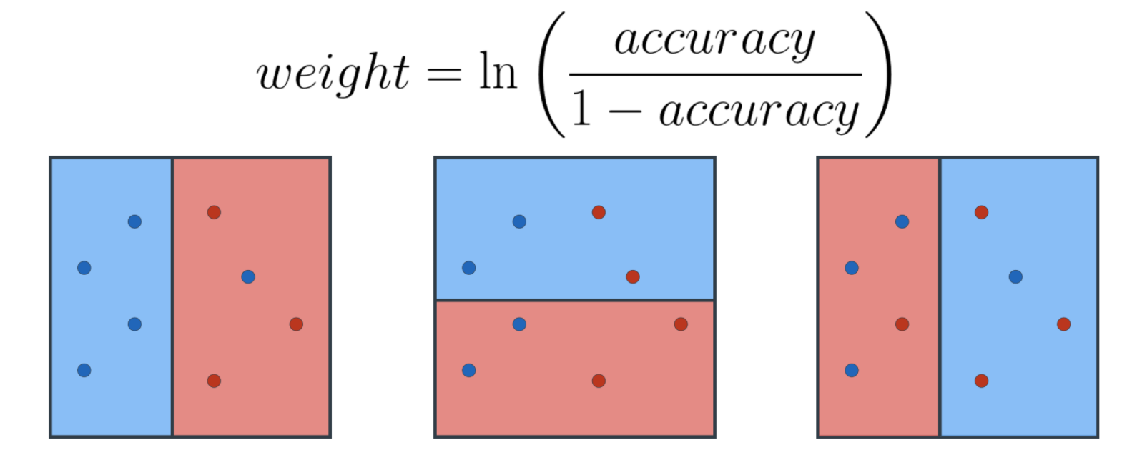
Calculate the weights of the three models:

Slide 44
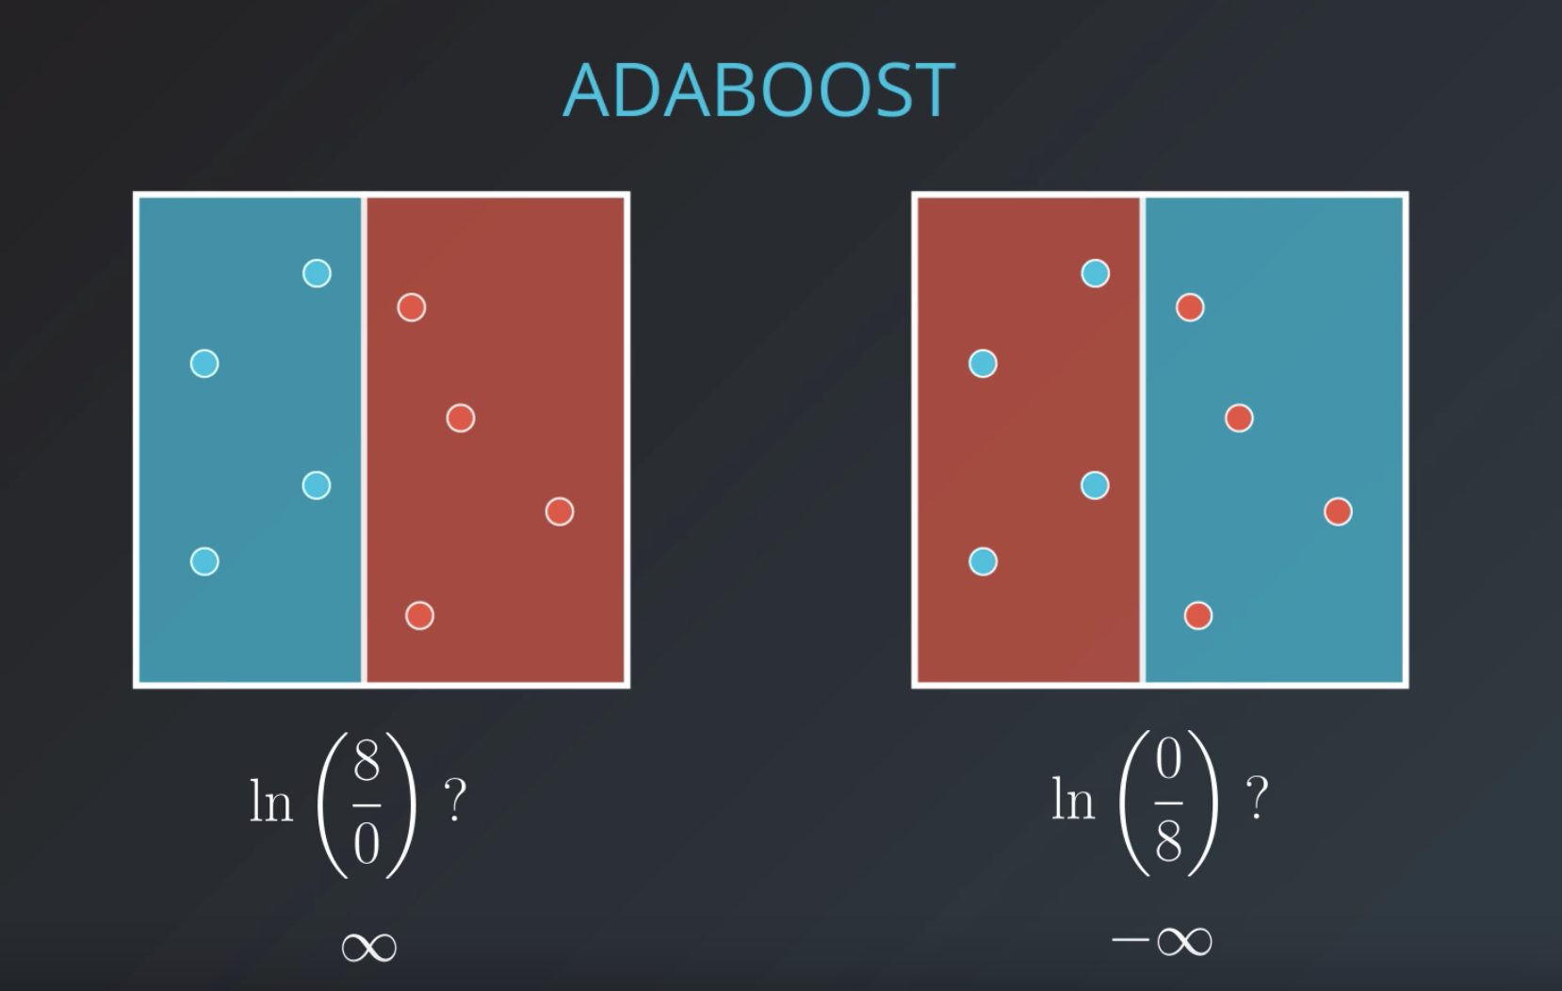

Slide 45
Combining the models:
Get the weights of all three models before

Slide 46
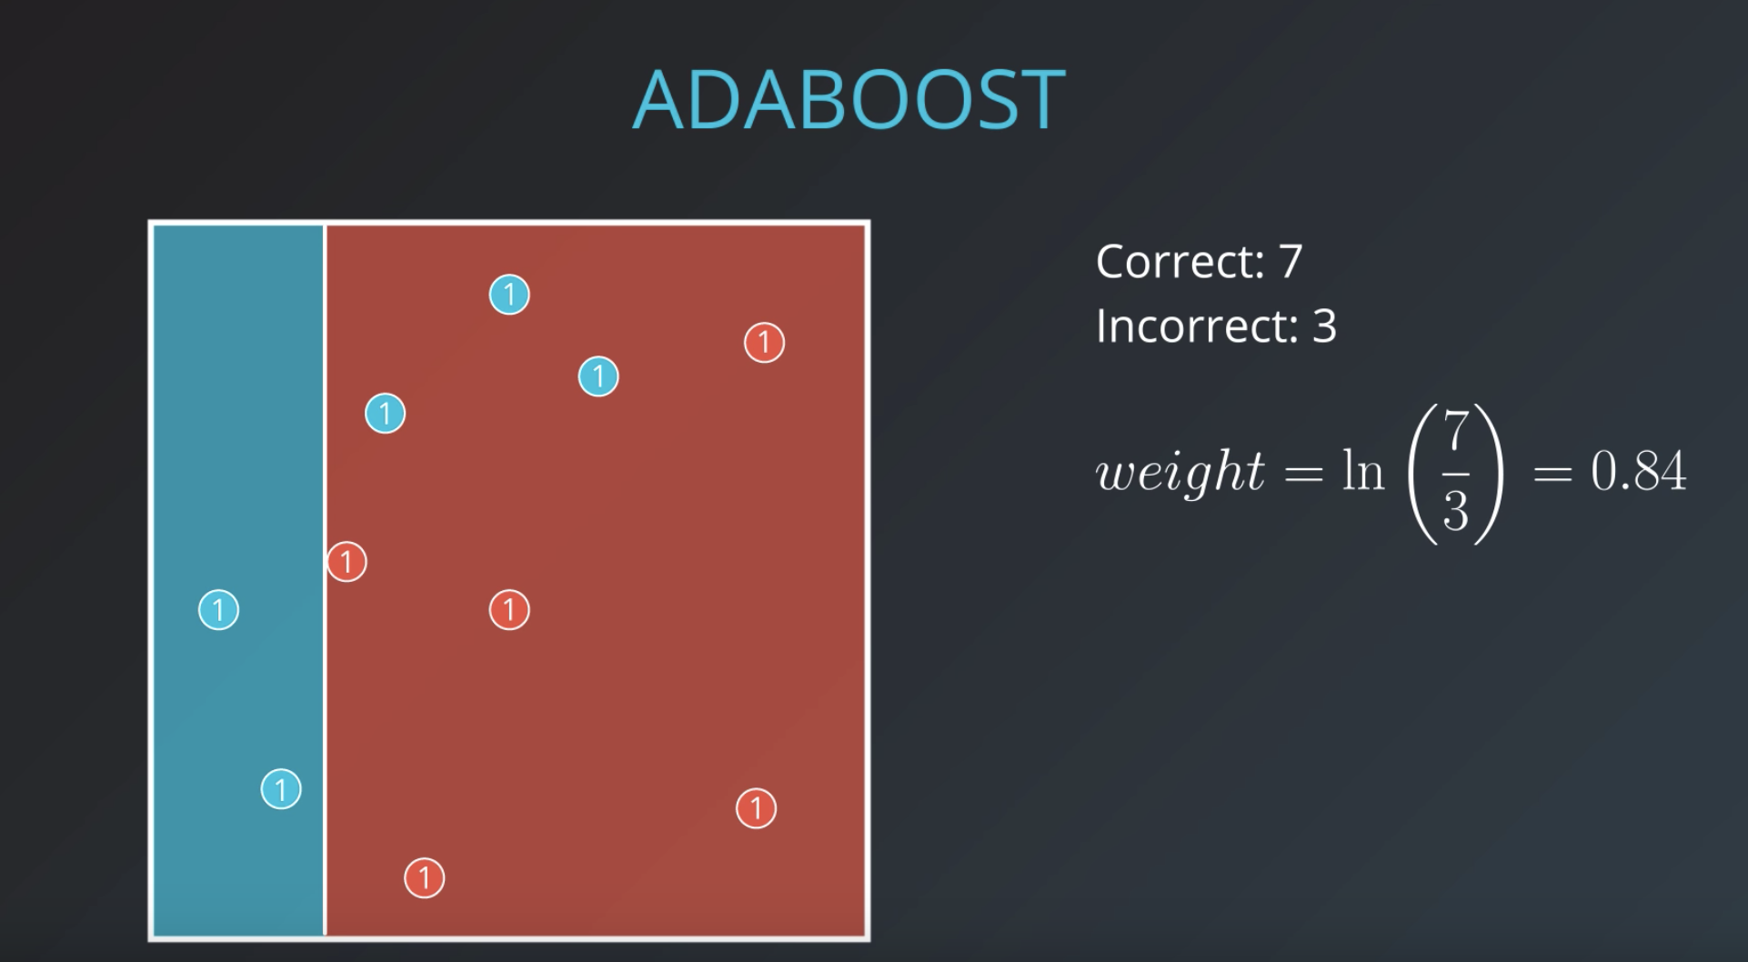
Combining the models:

Slide 47
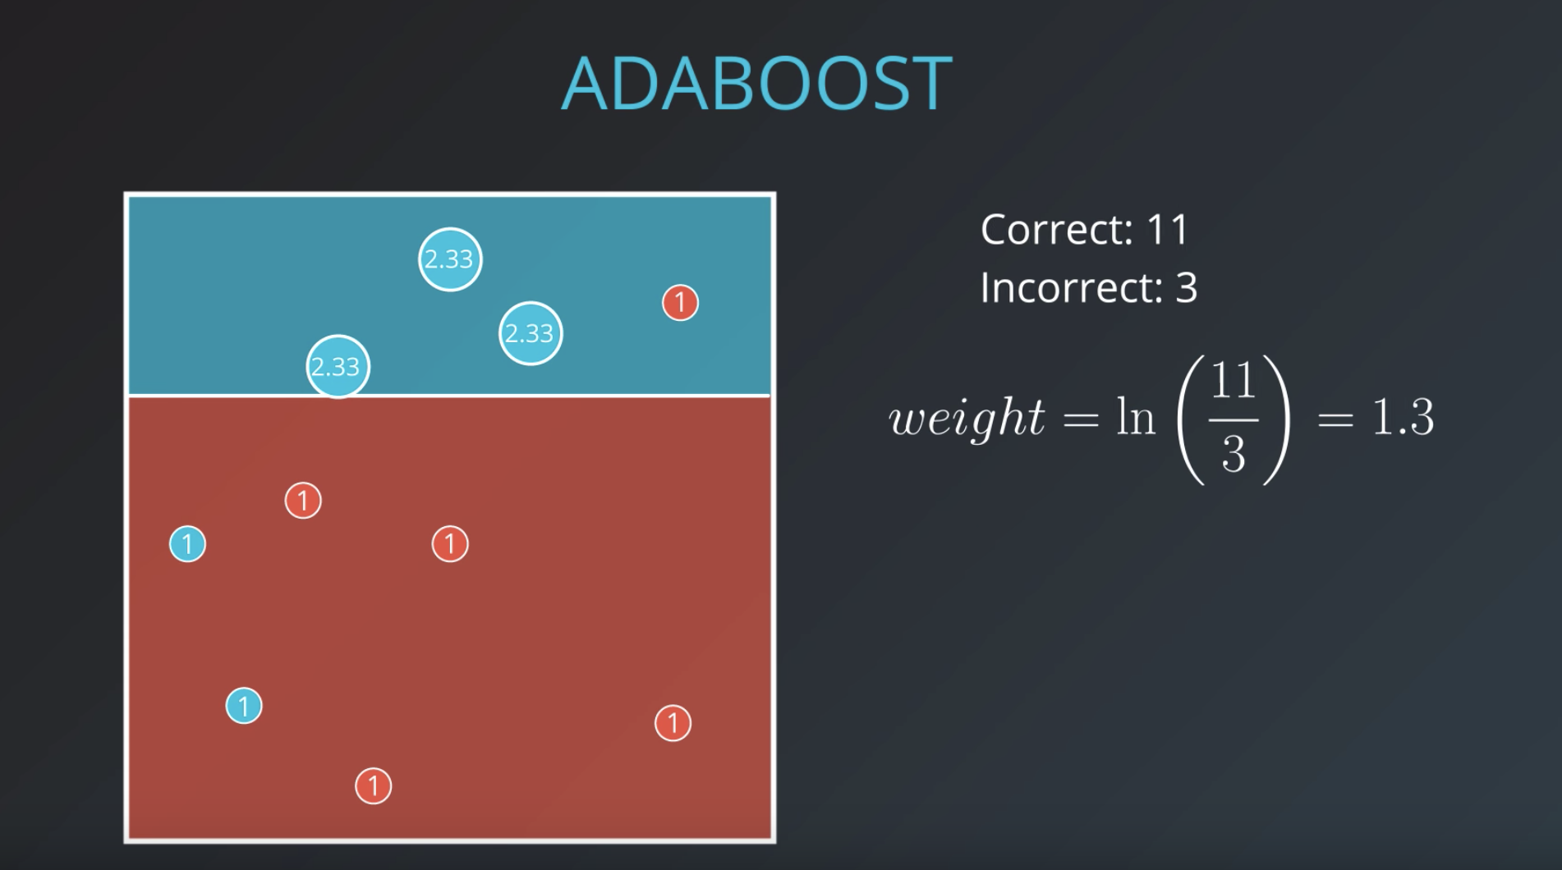

Slide 48
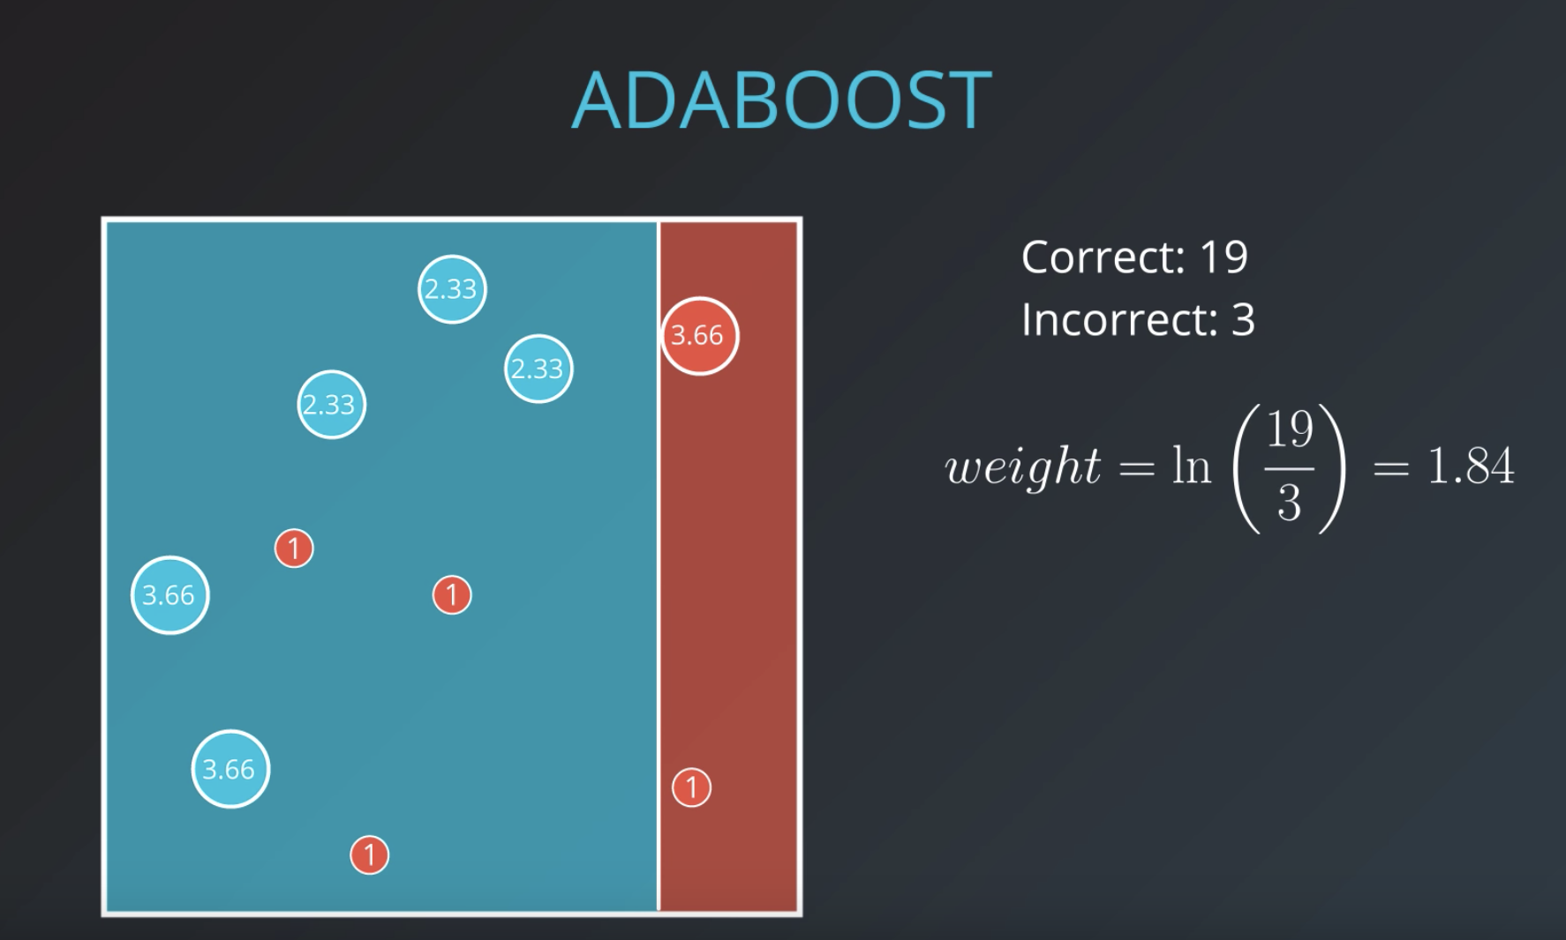

Slide 49
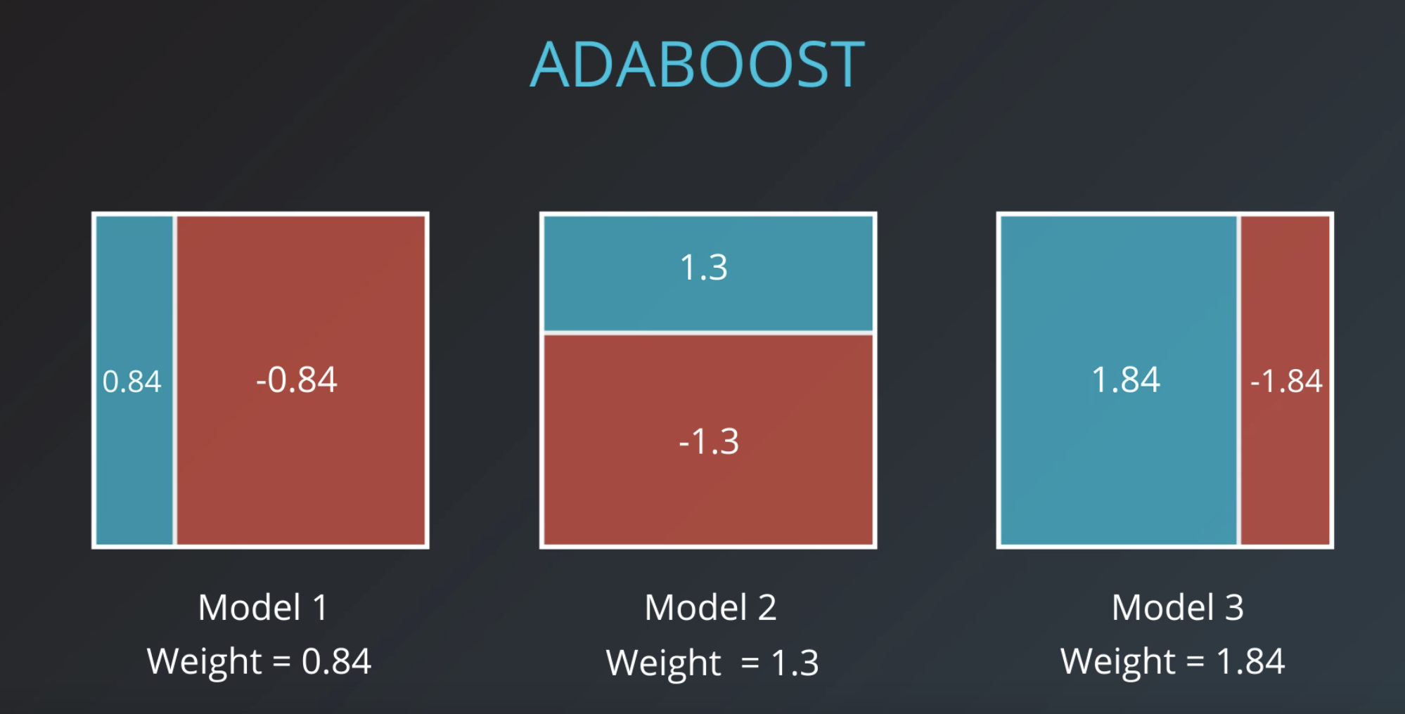

Slide 50
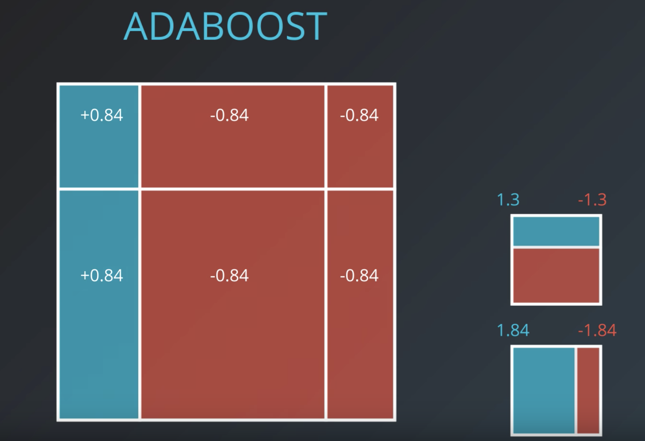

Slide 51
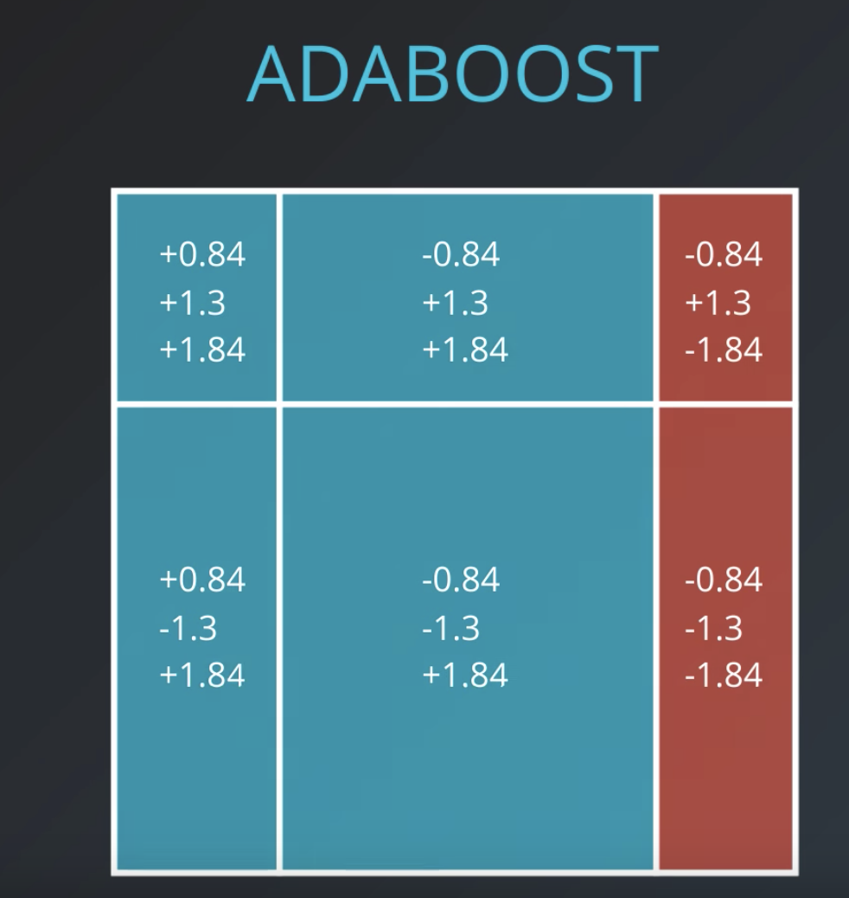

Slide 52
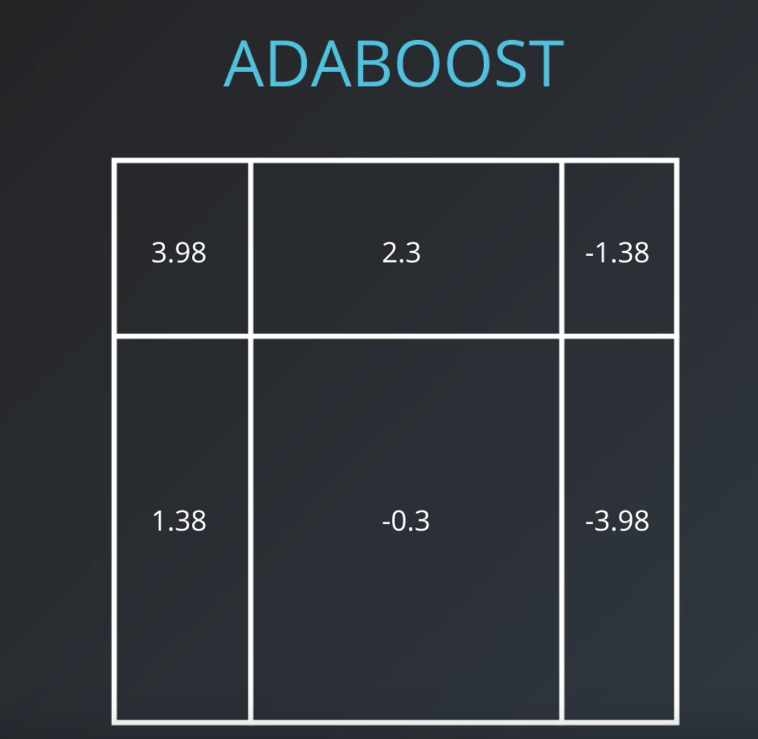

Slide 53
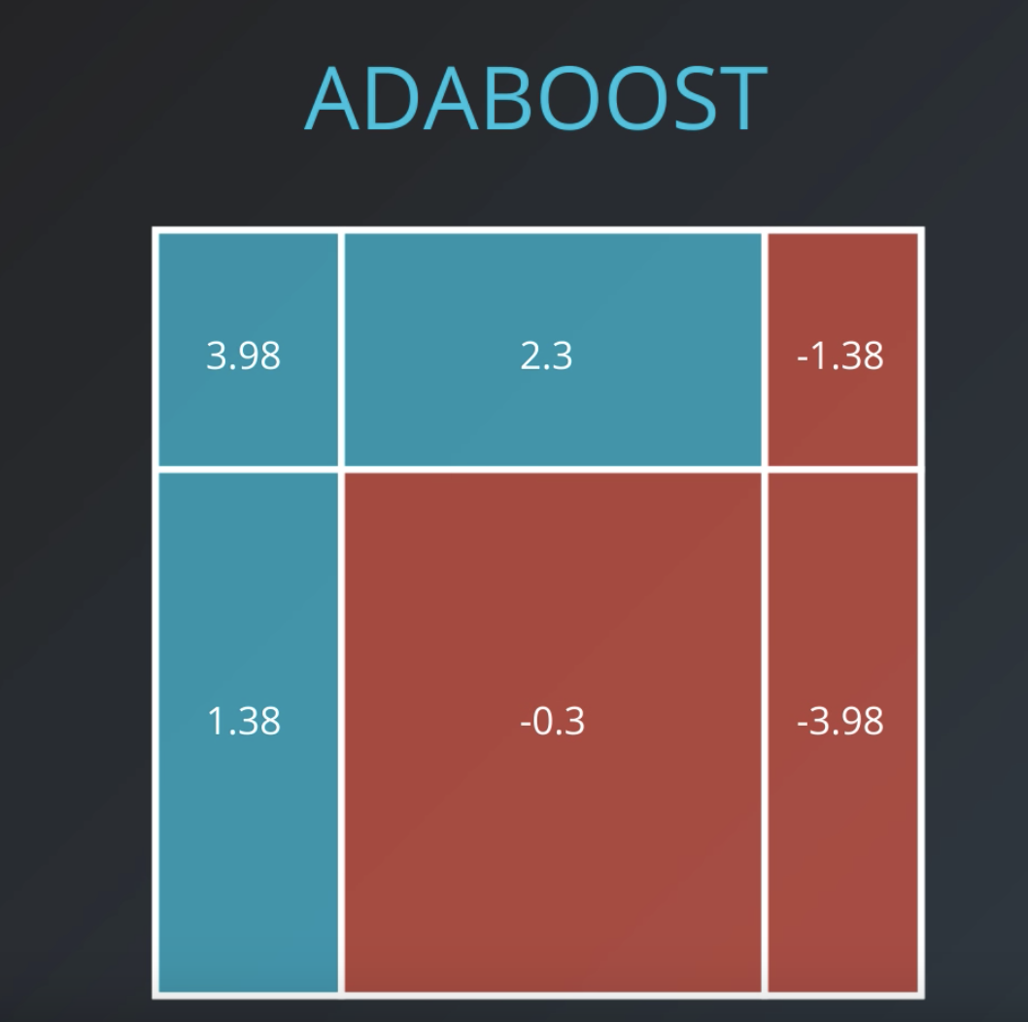
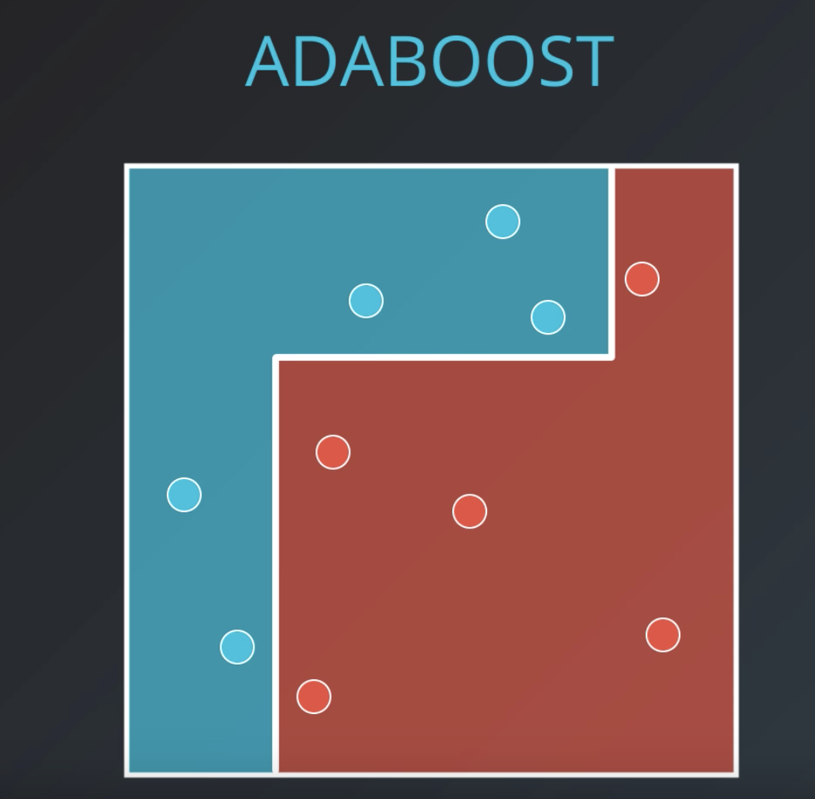

Slide 54
The End

